Slide 1
Lecture 18: Variational Autoencoders

Slide 2
Outline
Motivation for Variational Autoencoders (VAE)
Mechanics of VAE
Separability of VAE
Training and the math behind everything

Slide 3
Outline
Motivation for Variational Autoencoders (VAE)
Mechanics of VAE
Separability of VAE
Training and the math behind everything

Slide 4
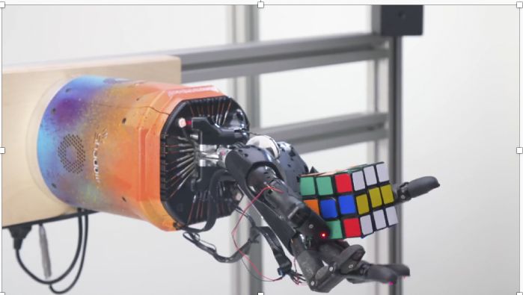
State of the Art in AI
https://openai.com/blog/solving-rubiks-cube/
Notes:
Open ai (for profit and not for profit organizzation promote and develop friendly AI - Ellon Musk Sam Altman)
Rubik's cube
Train on infinite hours all GPUs in the world
Transfer learning

Slide 5
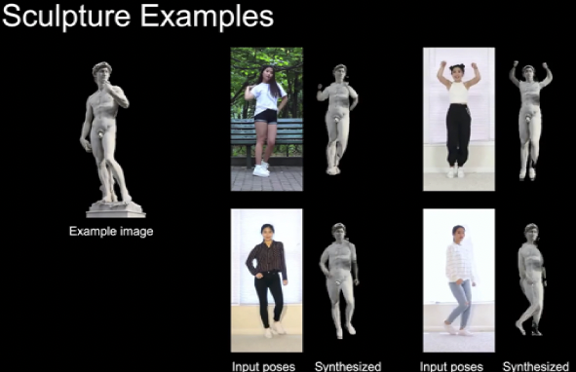
State of the Art in AI
https://nvlabs.github.io/few-shot-vid2vid/
Notes:
Nvidia
Video to video
For each frame they transfer style from David Michalangelo – Galeria d’academia

Slide 6
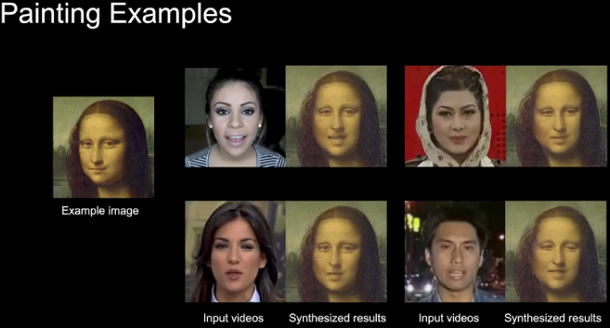
State of the Art in AI
https://nvlabs.github.io/few-shot-vid2vid/
Notes:
Nvidia: same thing
Mona Lisa
L - D vici

Slide 7
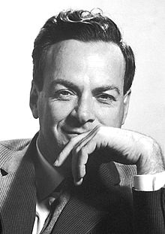
Generative Modeling
“What I cannot create, I do not understand.”
- Richard Feynman

Slide 8
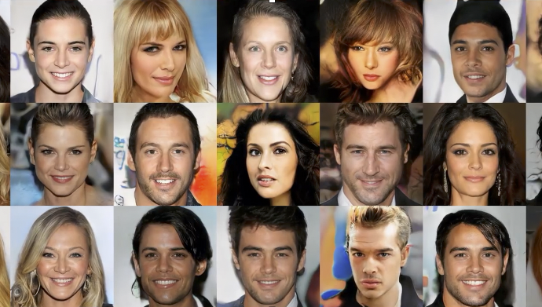
Generative Modeling
https://github.com/tkarras/progressive_growing_of_gans
Notes:
Pure Generator: proGAN, original distribution CelebA-HD
nvidia

Slide 9
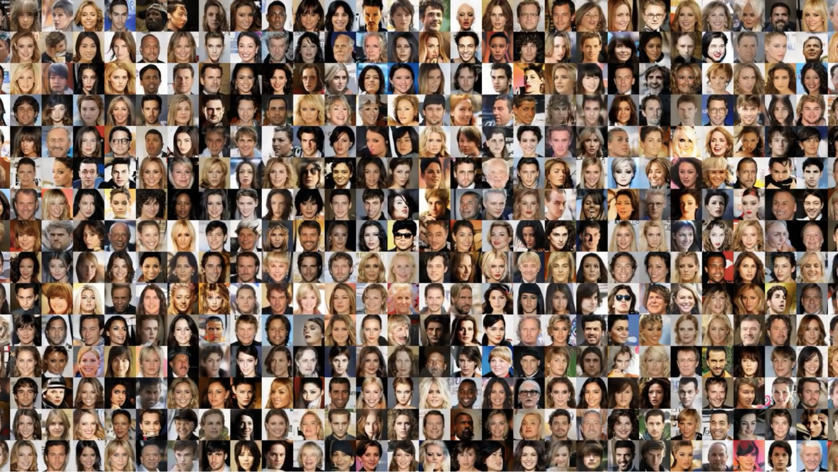
Generative Modeling
https://github.com/tkarras/progressive_growing_of_gans

Slide 10
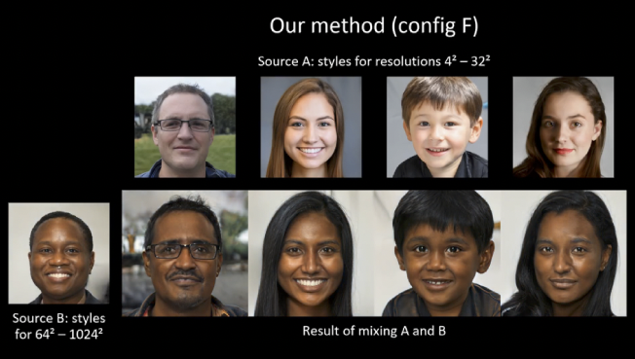
Generative Modeling
https://github.com/NVlabs/stylegan2
Notes:
Nvidia: styleGAN-2 upper raw source A, bottom left source B

Slide 11
Generative Modeling
https://arxiv.org/pdf/1708.05509.pdf

Slide 12
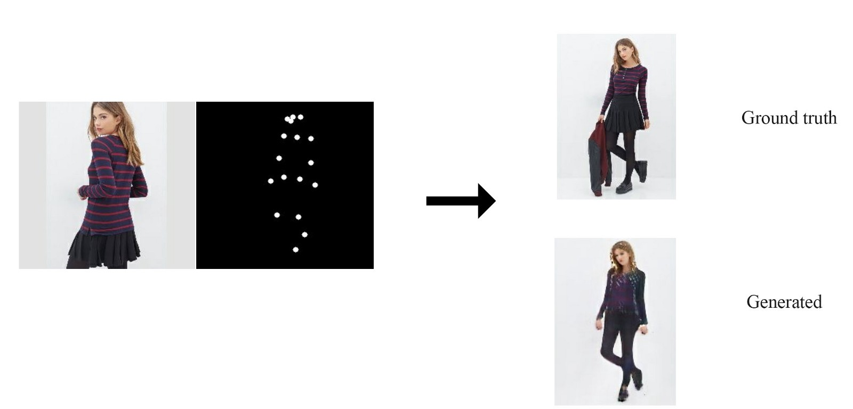
Generative Modeling

Slide 13
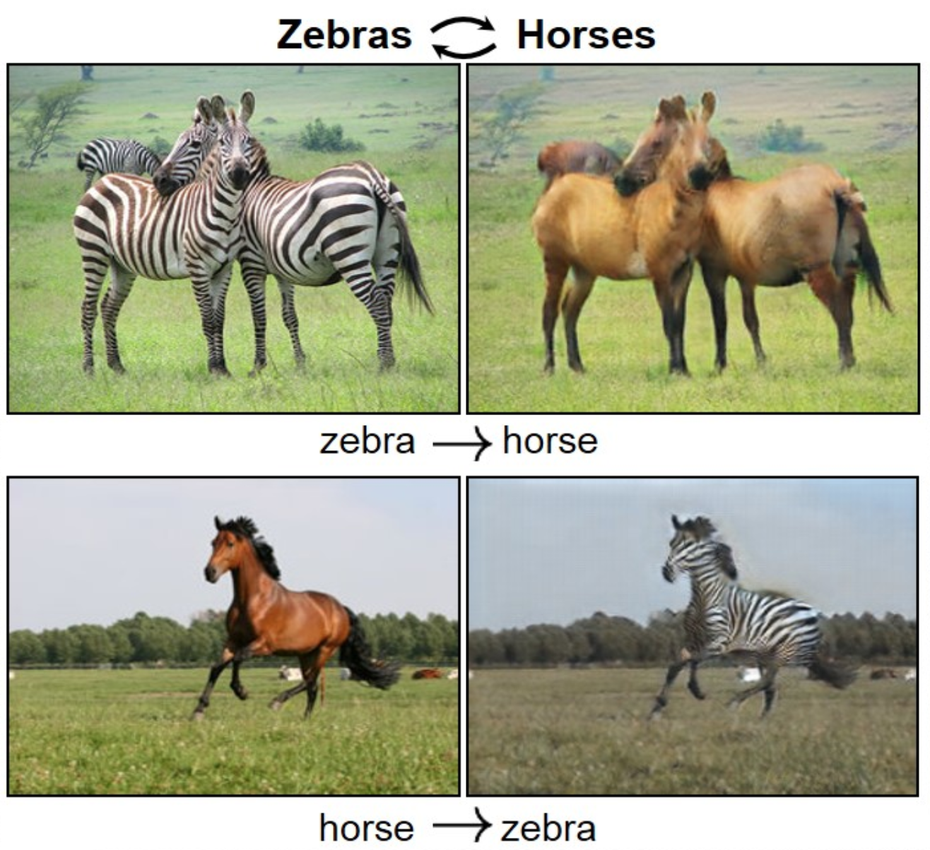
Generative Modeling

Slide 14
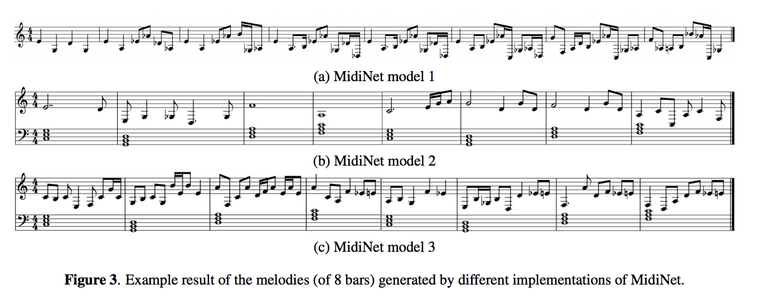

Slide 15
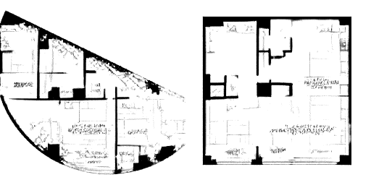
Another use of generating new data is to give us ideas and options. Suppose we’re planning a house. We can give the computer the space we have available, and its location. From this, the computer can can give us some ideas.

Slide 16
Big networks require big data, and getting high-quality, labeled data is difficult. If we’re generating that data our selves, we can make as much of it as we like.

Slide 17
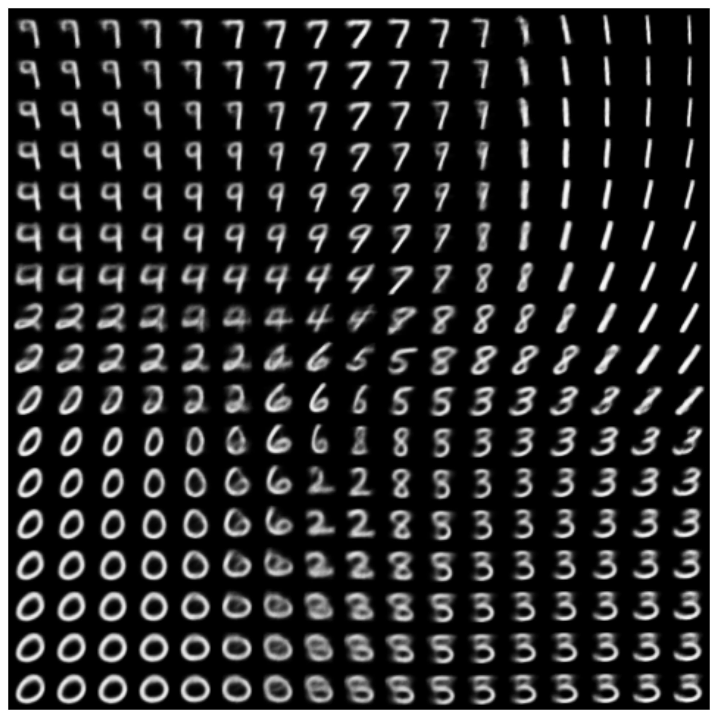

Generating Data
We saw how to generate new data with a AE in Lecture 12.

Slide 18
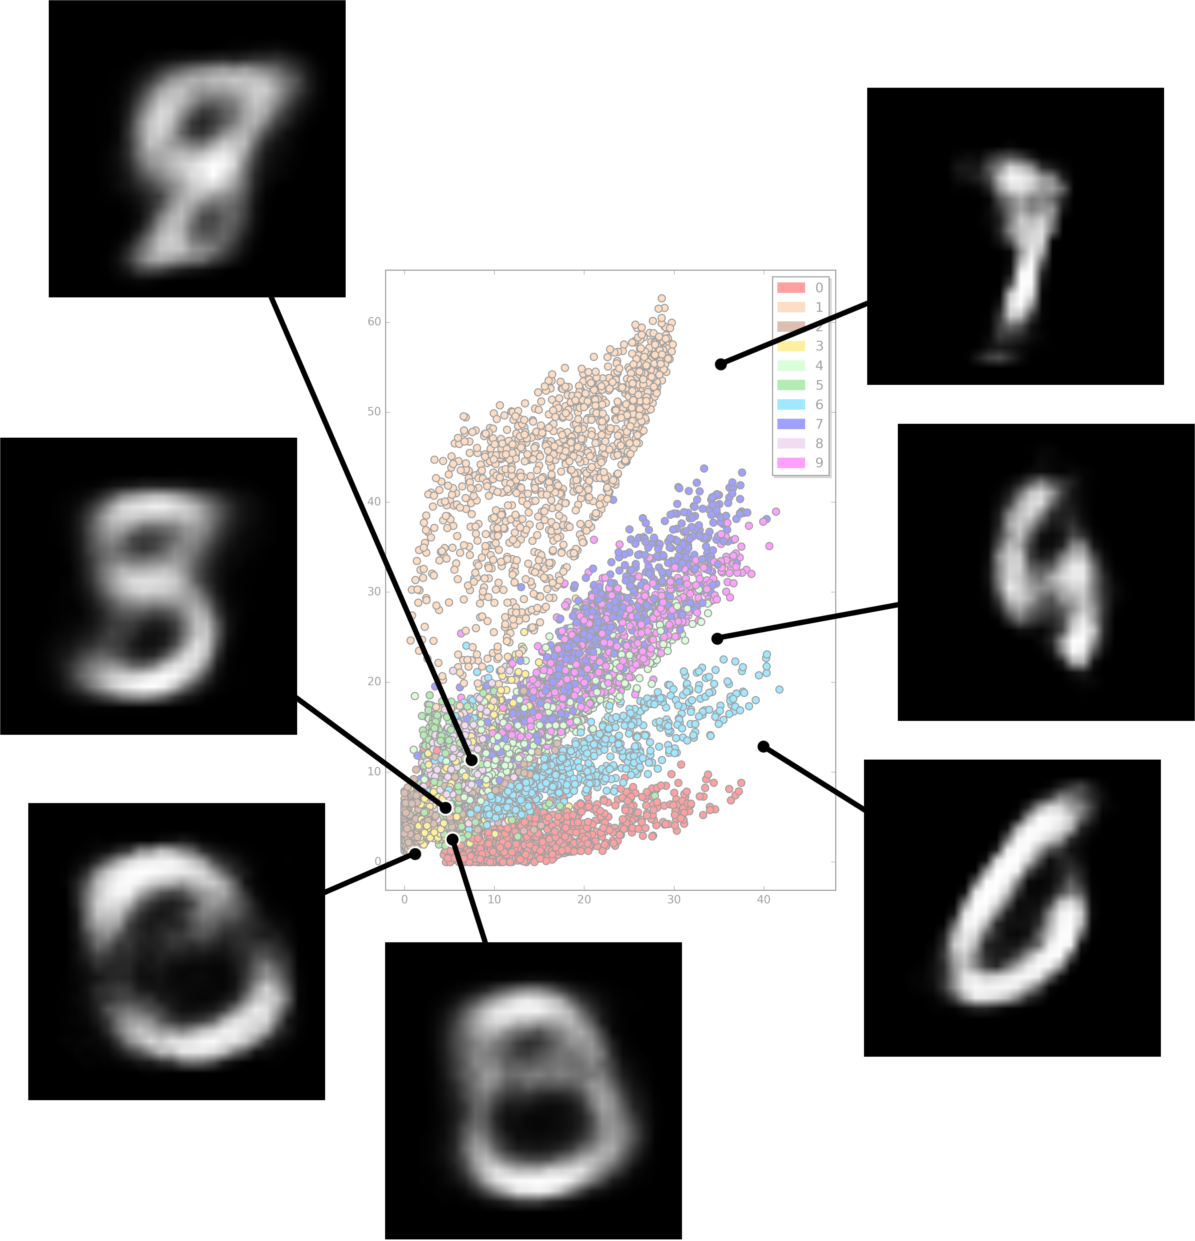
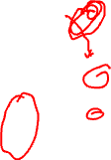
Problems with Autoencoders (from lecture 12)
Gaps in the latent space
Discrete latent space
Separability in the latent space

Slide 19
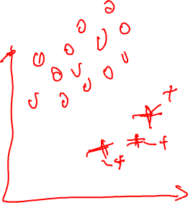
Outline
Motivation for Variational Autoencoders (VAE)
Mechanics of VAE
Separability of VAE
Training and the math behind everything

Slide 20
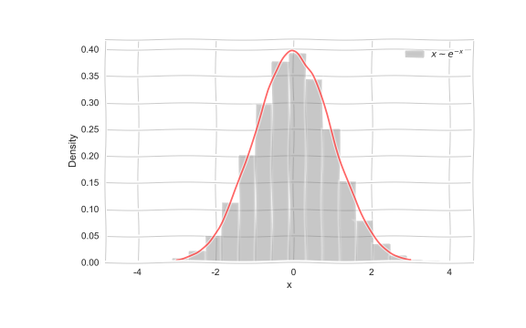
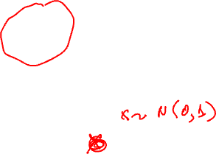
Generative models
Imagine we want to generate data from a distribution,
e.g.

Slide 21
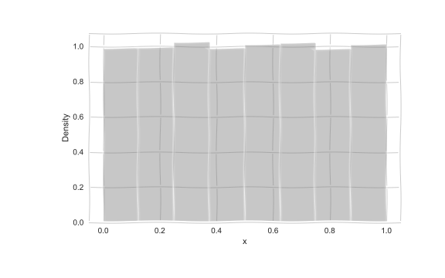
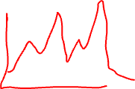
Generative models
But how do we generate such samples?

Slide 22
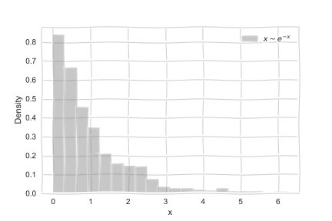
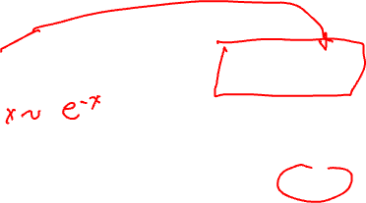
Generative models
But how do we generate such samples?

Slide 23
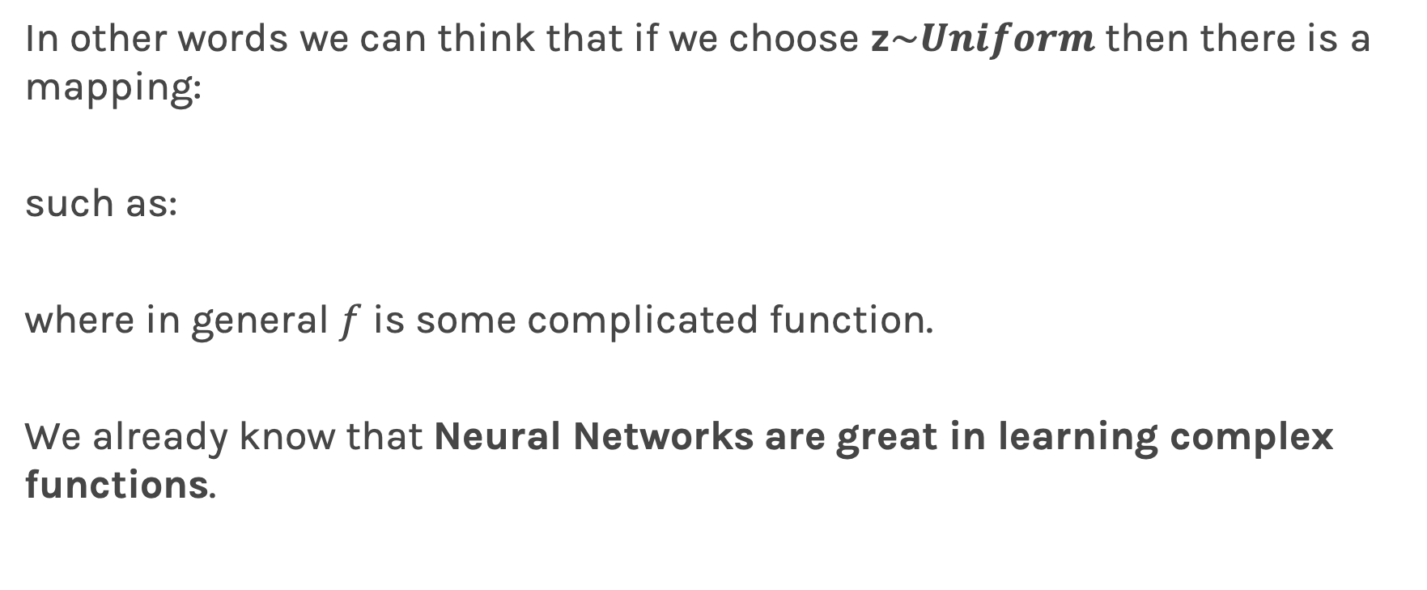
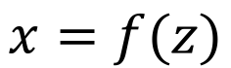
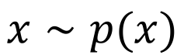
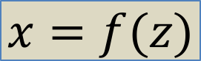
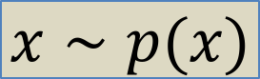
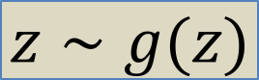
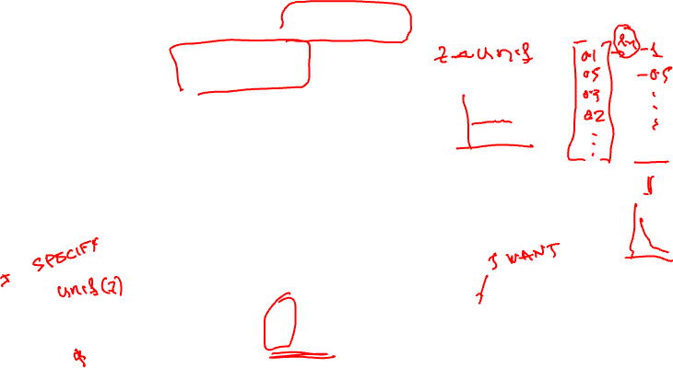
Generative models
In other words we can think that if we choose z$\sim Uniform$ then there is a mapping:
such as:
where in general $f$ is some complicated function.
We already know that Neural Networks are great in learning complex functions.
$$x=f(z)$$
$$x∼p(x)$$
$$z∼g(z)$$
$$x=f(z)$$
$$x∼p(x)$$

Slide 24
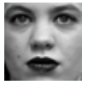
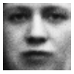
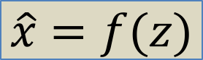
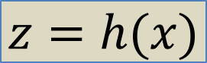
Traditional Autoencoders
In traditional autoencoders, we can think of encoder and decoders as some function mapping.
Encoder
z
Decoder
$$z=h(x)$$
$$\hat{x}=f(z)$$

Slide 25
Variational Autoencoders
To go to variational autoencoders, we need to first add some stochasticity and think of it as a probabilistic modeling.
Encoder
z
Decoder

Slide 26


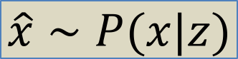
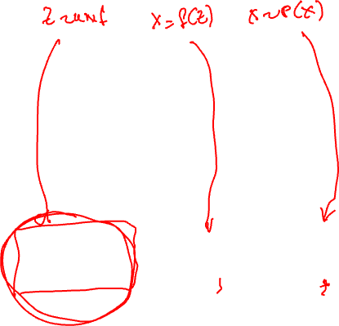
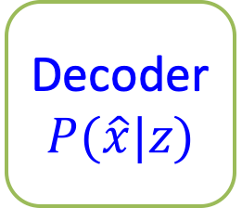
Variational Autoencoders
Sample from g(z)
e.g. Standard Gaussian
z
Decoder
$$P(\hat{x}|z)$$
$$z∼g(z)$$
$$\hat{x}=f(z)$$
$$\hat{x}∼P(x|z)$$

Slide 27
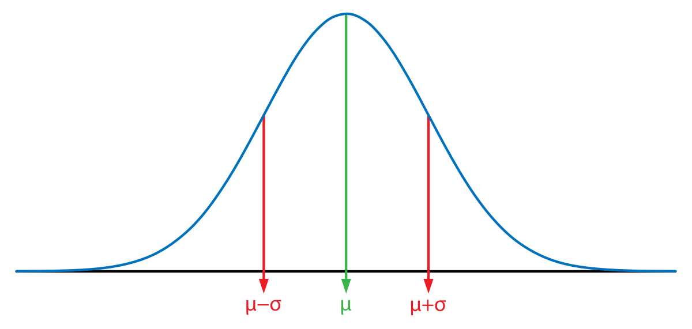
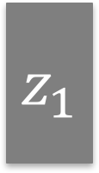
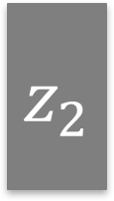
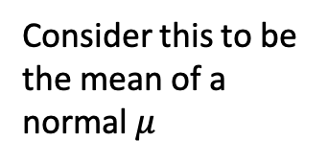
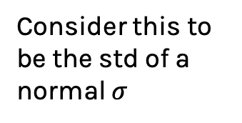
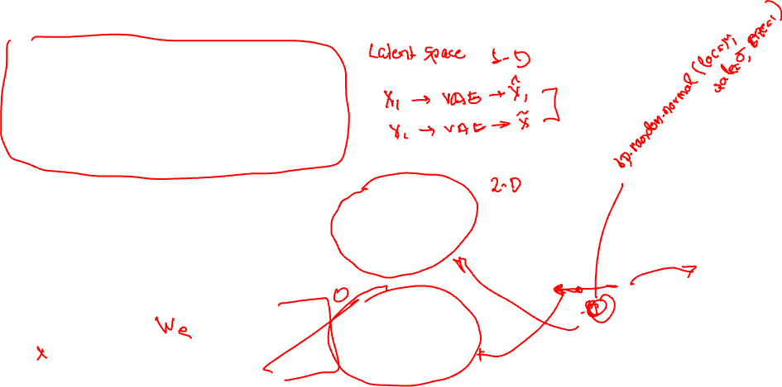
Variational Autoencoders
Traditional AE
Encoder
z
$$z_{1}$$
Consider this to be the mean of a normal $μ$
Encoder
Decoder
$$z_{2}$$
Consider this to be the std of a normal $σ$
Randomly chosen value
Latent value, z

Slide 28
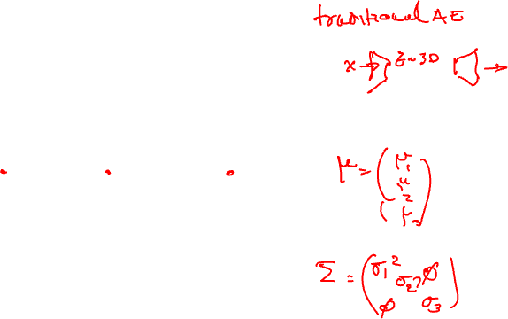
Variational Autoencoders

Slide 29
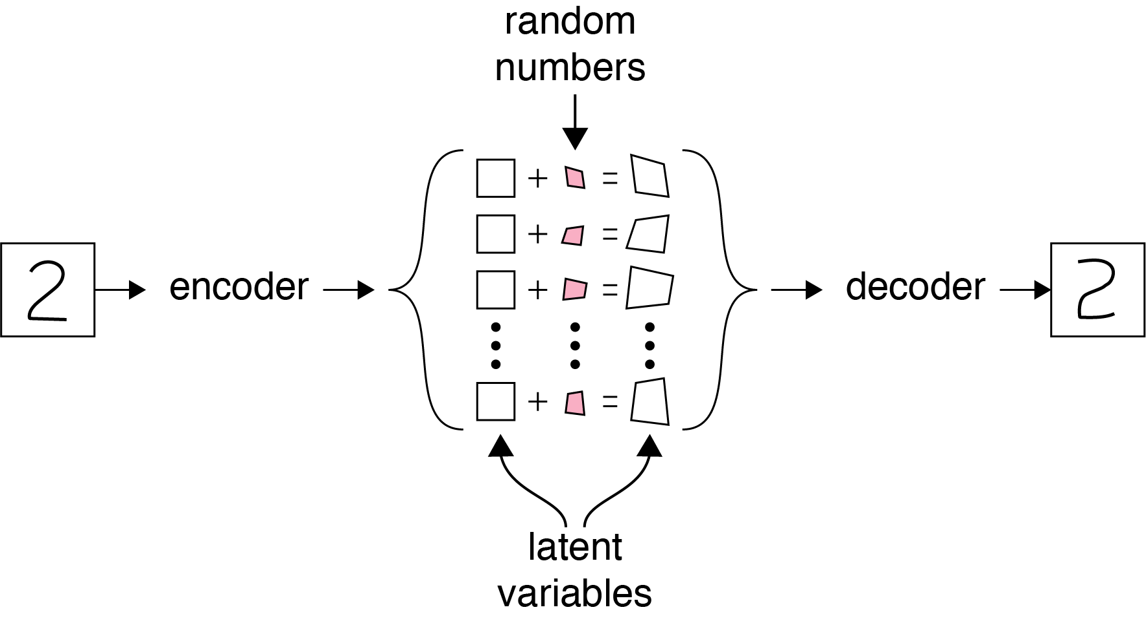
Variational Autoencoders

Slide 30
Variational Autoencoders
512 neurons
ReLU
256 neurons
ReLU
20 neurons
ReLU
256 neurons
ReLU
512 neurons
ReLU
784 neurons
ReLU
Centers
512 neurons
ReLU
256 neurons
ReLU
20 neurons
ReLU
256 neurons
ReLU
512 neurons
ReLU
784 neurons
ReLU
Random Variable
Spreads

Slide 31
Outline
Motivation for Variational Autoencoders (VAE)
Mechanics of VAE
Separability of VAE
Training and the math behind everything

Slide 32
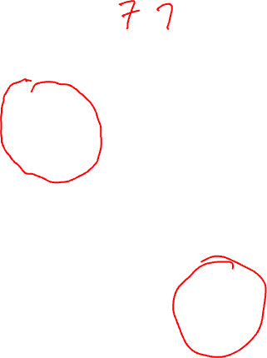
Separability in Variational Autoencoders
Separability is not only between classes but we also want similar items in the same class to be near each other.
This is similar to word encoding we have talked in the previous lecture.
For example, there are different ways of writing “2”, we want similar styles to end up near each other.
Let’s examine VAE, there is something magic happening once we add stochasticity in the latent space.

Slide 33
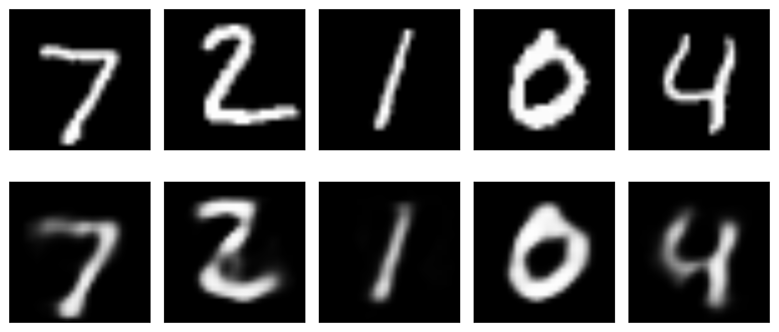
Separability in Variational Autoencoders
Latent Space
ENCODER
DECODER
Encode the first sample (a “2”) and find $μ_{1}, σ_{1}$

Slide 34
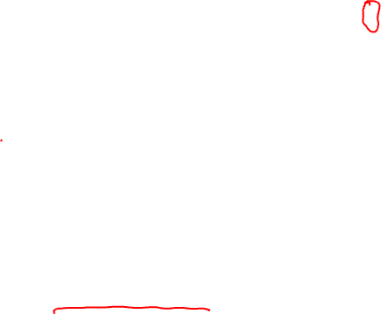
Separability in Variational Autoencoders
Latent Space
ENCODER
DECODER
Sample $z_{1}∼N(μ_{1}, σ_{1})$

Slide 35
Blending Latent Variables
Latent Space
ENCODER
DECODER
D$ecode to {\hat{x}}_{1}$

Slide 36

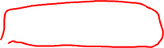
Separability in Variational Autoencoders
Latent Space
ENCODER
DECODER
Encode the second sample (a “3”) find $μ_{2}, σ_{2}.$Sample $z_{2}∼N(μ_{2}, σ_{2})$

Slide 37

Separability in Variational Autoencoders
Latent Space
ENCODER
DECODER
D$ecode to {\hat{x}}_{2}$

Slide 38
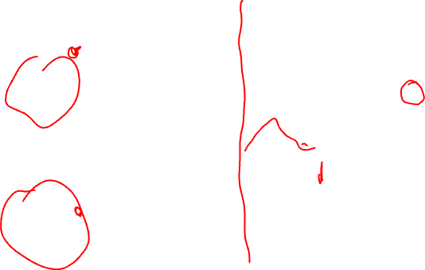
Separability in Variational Autoencoders
Latent Space
ENCODER
DECODER
Train with the first sample (a “2”) again and find $μ_{1}, σ_{1}.$ However $z_{1}∼N(μ_{1}, σ_{1})$ will not be the same. It can happen to be close to the “3” in latent space.

Slide 39
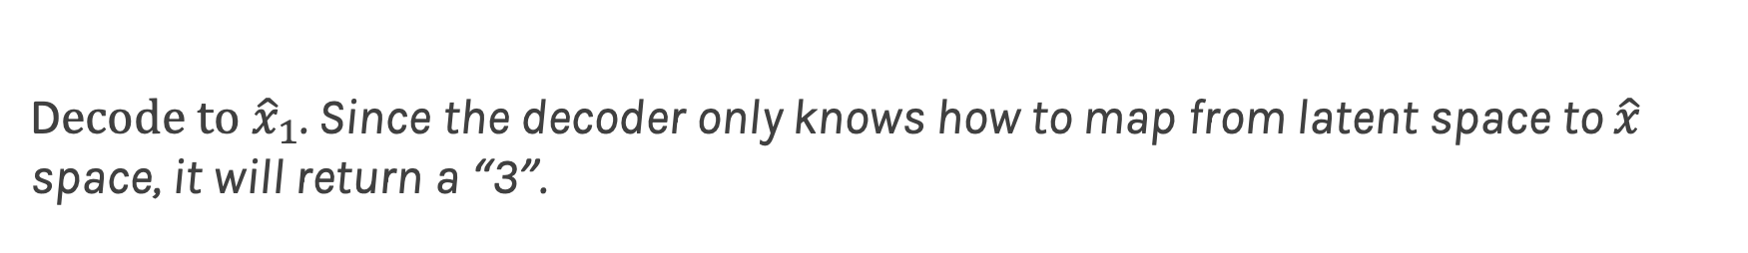
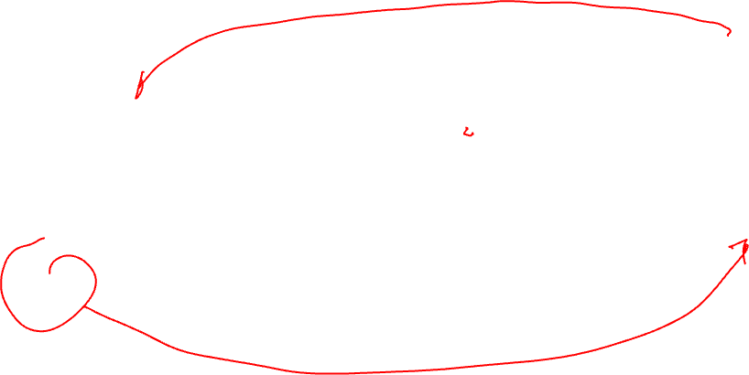
Separability in Variational Autoencoders
Latent Space
ENCODER
DECODER
D$ecode to {\hat{x}}_{1}$. Since the decoder only knows how to map from latent space to $\hat{x}$ space, it will return a “3”.

Slide 40


Separability in Variational Autoencoders
Train with 1st sample again
Latent Space
ENCODER
DECODER
Latent space starts to
re-organize

Slide 41

Separability in Variational Autoencoders
And again…
Latent Space
ENCODER
DECODER
3 is pushed away

Slide 42
Separability in Variational Autoencoders
Many times…
Latent Space
ENCODER
DECODER

Slide 43

Separability in Variational Autoencoders
Now lets test again
Latent Space
ENCODER
DECODER

Slide 44

Separability in Variational Autoencoders
Training on 3’s again
Latent Space
ENCODER
DECODER

Slide 45

Separability in Variational Autoencoders
Many times…
Latent Space
ENCODER
DECODER

Slide 47
Outline
Motivation for Variational Autoencoders (VAE)
Mechanics of VAE
Separability of VAE
Training and the math behind everything

Slide 48


















Training
Encoder
$$μ$$
Decoder
$$W_{E}$$
$$W_{D}$$
$$x$$
$$z$$
$$\hat{x}$$
$$σ$$
Training means learning $W_{E}$ and $W_{E}$.
Define a loss function $ℒ$
Use stochastic gradient descent (or Adam) to minimize $ℒ$
The Loss function:
Reconstruction error: $ℒ_{R}=\frac{1}{n}\sum_{i}{{\left(x_{i}−{\hat{x}}_{i}\right)}^{2}}$
Similarity between the probability of z give x and $p\left(z | x\right)$ and some predefine probability distribution $p(z)$, which can be given by Kullback-Leibler divergence (KL): $KL(p(z|x)||p\left(z\right))$ [Note: we will get into the details in the a-section]

Slide 49












Bayesian AE
Encoder
$$μ$$
Decoder
$$W_{E}$$
$$W_{D}$$
Bayes rule:
$$x$$
$$z$$
$$\hat{x}$$
p$\left(θ | D\right)∝p\left(D | θ\right)p\left(θ\right)$
$$σ$$
Parameters of the model ($θ$ is z)
Posterior for our parameters, z is:
p$\left(z | x, \hat{x}\right)∝p\left(\hat{x} | z,x\right)p\left(z\right)$
Posterior predictive, probability to see $\hat{x}$ given $x;$this is INFERENCE:
p$\left(\hat{x} | x\right)=∫p\left(\hat{x} | z, x\right)p\left(z | x\right)dz$
Decoder: NN
Posterior

Slide 50

Bayesian AE
The posterior, $P\left(z | x, \hat{x}\right)$, can be sampled with MCMC, i.e. no minimization of Loss function. How?
Set the priors, $p\left(z\right)$
Define the likelihood, $P\left(\hat{x} | z,x\right)$
Propose a new z* and:
check if $P\left(z^{∗} | x, \hat{x}\right)$/$P\left(z | x, \hat{x}\right)$ >1: accept, $z^{∗}$
If $P\left(z^{∗} | x, \hat{x}\right)$/$P\left(z | x, \hat{x}\right)$ <1 throw a random coin and accept/reject $z^{∗}$
This will c$onverge to true P\left(z | x, \hat{x}\right)!$
Calculate $P\left(\hat{x} | x\right)=∫P\left(\hat{x} | z, x\right)P\left(z | x\right)dz$ (Note: this is easily done with sample from z and re-weight given the likelihood)
DOABLE!

Slide 51

Variational AE
Problem: z is the dimensionality of your latent space, which can be too large. In other words this$∫p\left(\hat{x} | z, x\right)p\left(z | x\right)dz$ becomes intractable.
Instead we turn this into a minimization problem – Variational Calculus
Find a q$\left(z | x\right)$ that is similar to $p\left(z | x\right)$ by minimizing their difference.
After some math:
Proposal distribution should resemble a Gaussian
Reconstruction Loss

Slide 52



Slide 53

Training VAE
Apply stochastic gradient descent (SGD)
Problem:
Sampling step not differentiable
Use a re-parameterization trick
Move sampling to input layer, so that the sampling step is independent of the model

Slide 54



Reparametrization Trick
Encoder
$$μ$$
Decoder
z
$$σ$$

Slide 55



Reparametrization Trick
Encoder
$$μ$$
Decoder
z
$$σ$$
$$Z= μ+ε∘σ$$

Slide 56


Reparametrization Trick
Encoder
$$μ$$
Decoder
z
$$σ$$
$$Z= μ+ε∘σ$$
$$ε ∼N(0,I)$$

Slide 57


Training VAE
Traditional AE:
Input Image:
Output Images:
Variational AE:
Input Image:
Output Images:
Difference:

Slide 58

Latent space of VAE
More separable than AE
Because of the prior N(0,1) everything is center at (0,0) with spread of approx 1.
Blending is more continuous because latent space is continuous

